Slide 1
[Presentation Title]
Month, Date, Year
presented by []

Slide 2
A tip from Aristotle
STEP 1
STEP 2
STEP 3
Tell them what you are going to tell them
Tell them
Tell them what you told them

Slide 3
Tell them what you are going to tell them

Slide 4
Table of content
WHAT WE’RE DOING
In today’s workshop, we will cover
The Essentials: Speaker Bio, Headshot, Abstract
Submitting a CFP (Call for Presentations)
Effective Use of Your Title Slide / Importance of Branding
Breaking Down the MONOLITH (slides, not microservices)
Making the Eyechart 20/20
Explaining Code in a Presentation
Adding Your Social Media Handles

Slide 5
Tell them

Slide 6
CALL for presentations

Slide 7
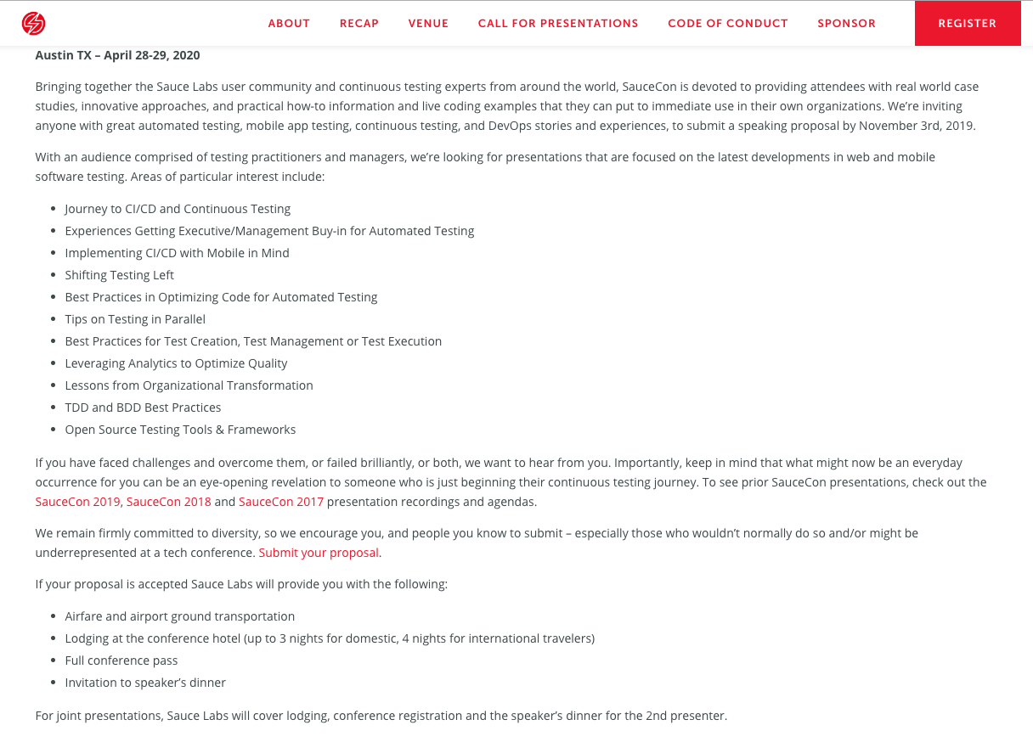
1
Event Dates
2. Topics of Interest / Tracks
2

Slide 8
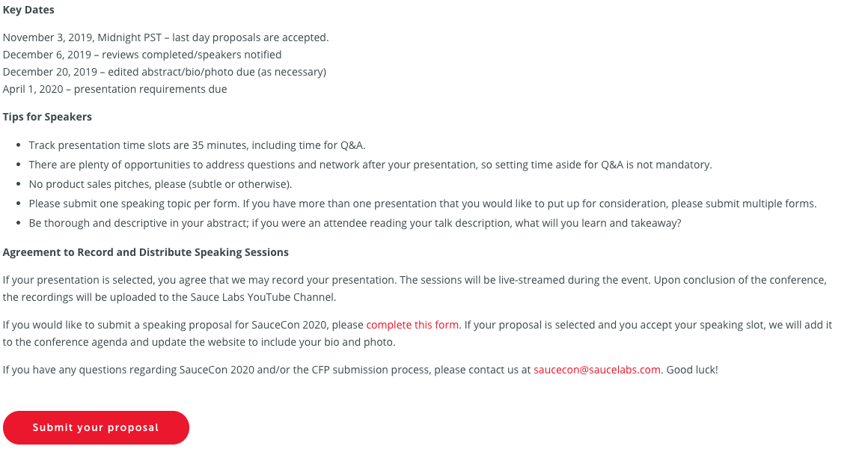
1
Key Dates – Submission Deadline
2
2. Topics of Interest / Tracks

Slide 9
THE ESSENTIALS: SPEAKER BIO, HEADSHOT, ABSTRACT

Slide 10

The essentials
Technically Speaking: Speaking at Tech Conferences
Abstract:
[Practice] We've been noticing a trend at tech conferences. A serious lack of diversity. While strides have been made in recent years to get much more gender diversity, there still exists a disturbing lack of black technical speakers.
When asked why it is so difficult to attract black speakers, conference organizers quickly point out the fact that black people are not submitting proposals to speak.
We're here to change that.
Talking about things that you know is not as difficult as you might think. Once you get used to the process of preparing talks and submitting proposals, it becomes easier each time.
Please join me as we go over very specific techniques for giving tech talks.
Speaker Bio:
[Practice] Avery Smith learned how to be an engineer by sitting with her father as he experimented with a brand new language called Objective-C. By the time she went to school to study Computer Science, she had already published her first app to the ACME store. Since then, Avery has held key roles three Fortune 50 Companies. Today, she works for the same ACME company where she published her app so many years ago.
https://pixabay.com/photos/curly-hair-headshot-portrait-young-2740602

Slide 11
Exercise 1: create a speaker bio (15 minutes)

Slide 12
Creating a speaker bio
Things to include
How did you get started in engineering?
What have you done since getting started?
What is your current job?
What do you do when you are not engineering?
Do you have an advanced degree?
Were you a part of a well known project?
Speaker Bio:
[Practice]
[Add your bio here]

Slide 13
The Abstract

Slide 14
Creating AN Abstract
Technically Speaking: Speaking at Tech Conferences
Abstract:
[Practice] We've been noticing a trend at tech conferences. A serious lack of diversity. While strides have been made in recent years to get much more gender diversity, there still exists a disturbing lack of black technical speakers.
When asked why it is so difficult to attract black speakers, conference organizers quickly point out the fact that black people are not submitting proposals to speak.
We're here to change that.
Talking about things that you know is not as difficult as you might think. Once you get used to the process of preparing talks and submitting proposals, it becomes easier each time.
Please join me as we go over very specific techniques for giving tech talks
Things to Keep In mind
What are you going to be talking about?
Why is it important? How would it benefit the audience?
Explain your research
Conclusion
Sales Pitch
Typical short 250 – 300 words

Slide 15
Exercise 2: Submitting a cfp (5 minutes)

Slide 16
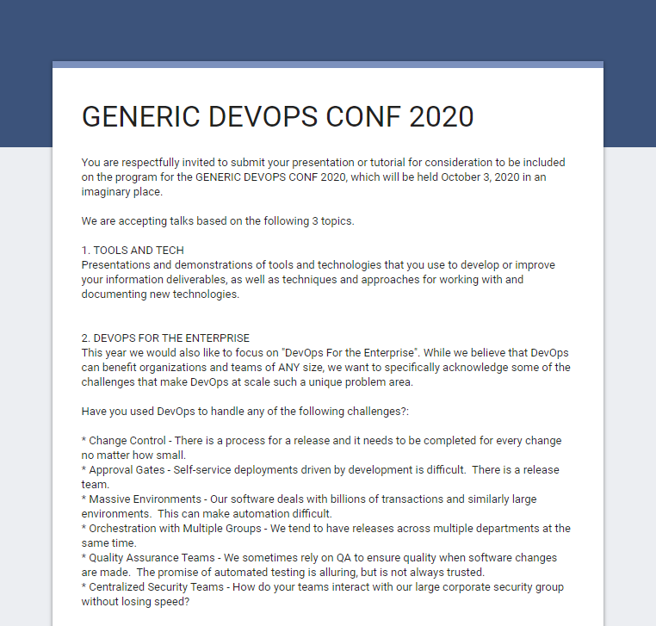
Submitting a cfp
GENERIC DEVOPS CONF 2019
Use your speaker’s bio you created earlier
Use the sample abstract provided or get creative
This is not a real conference … you are safe to submit
Other CFPs are similar to this
Generic DevOps Conf 2020 CFP ( https://forms.gle/JuMq66c5FC8hStx68 )

Slide 17
EFFECTIVE USE OF YOUR TITLE SLIDE

Slide 18
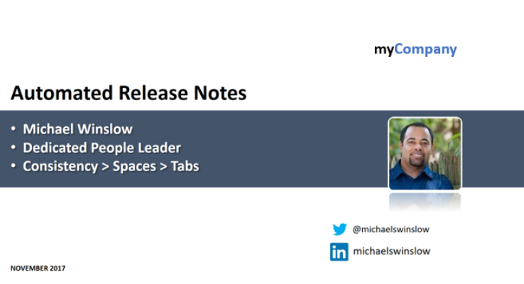
EFFECTIVE USE OF YOUR TITLE SLIDE
Never miss an opportunity to brand (subtly)
1
Screen may be displayed for a long time before you start speaking (free advertisement)
Title
Name
Job Function
Fun Fact
Company
Photo
Contact Information
Date of Presentation
6
2
3
7
4
5
8
Copy
XX%
9

Slide 19
Exercise 3: go back and modify the title slide of this presentation (5 minutes)

Slide 20
Breaking down the monolith (slides)

Slide 21

Key Performance Indicators
7 Billions documents
15 Terabytes of data currently ingested
32+ Terabytes of storage available (includes replication)
100k Monthly searches on average
30 Monthly users on average
10 Monthly unique users on average
Thoughts:
This is often too much to digest at once
People start reading ahead
You may lose track of where you are

Slide 22
Key Performance Indicators
7 Billions documents
15 Terabytes of data currently ingested
32+ Terabytes of storage available (includes replication)
100k Monthly searches on average
30 Monthly users on average
10 Monthly unique users on average

Slide 23
Exercise 4: Make the next slide clearer by breaking it down (10 minutes)

Slide 24

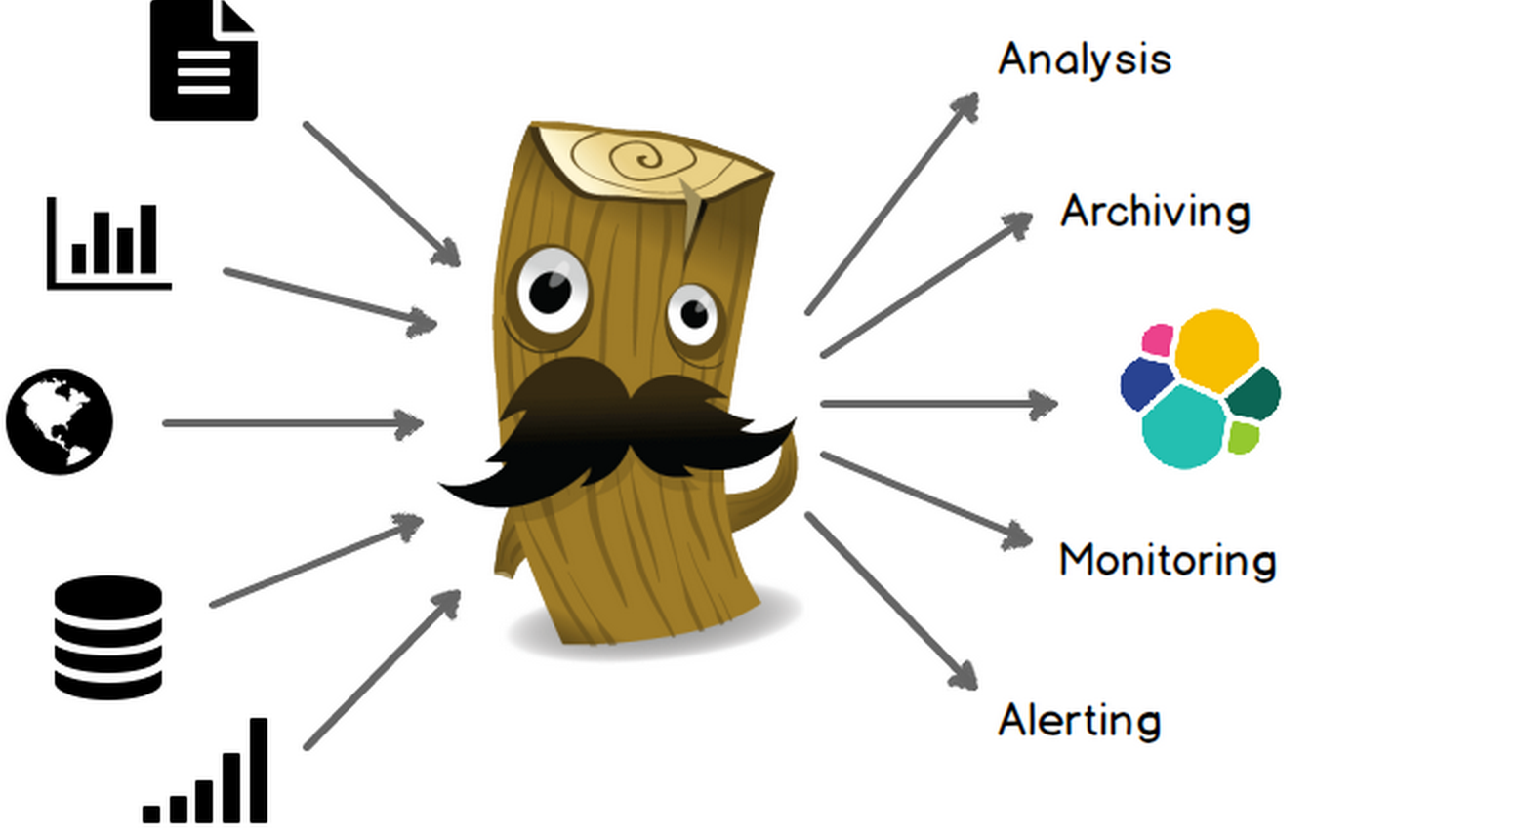




ELKaaS Components
Data Shippers
Filebeat – log data shipper
Packetbeat – real-time network analyzer
Topbeat – reads system-wide and per-process CPU and memory statistics
Customer provided shippers that can send data to Kafka APIs/endpoints
Logstash – open source data collection engine with real-time pipelining capabilities
Producers
Consumers
Elasticsearch – highly scalable open-source full-text search and analytics engine
Data node/s
Master node/s
Client node/s
Tribe node/s
Kibana – open source visualization platform
Kafka – distributed streaming platform
Zookeeper – centralized service for maintaing configuration information
Security - Access Controls, transport layer security (optional)

Slide 25
Making the eyechart 20/20

Slide 26
Read this…
Note: Select one volunteer to read this, while everyone else views the next slide
A simple microservice description
First, a HTTP request comes into the gateway
The gateway determines if the request is meant for the “eligibility”, “user” or “device” microservice and routes it accordingly
If one microservice gets overloaded with requests (“eligibility”), additional microservices can be added to handle the load
Service discovery detects with the new microservices are added, and adds them to the gateway
All of the identical microservices begin to balance the traffic equally

Slide 27
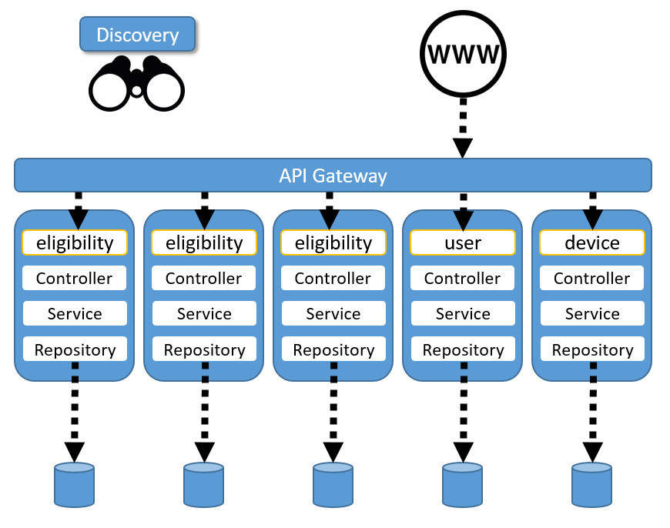
Thoughts:
This is often too much to digest at once
People not familiar with the architecture will be confused
You may not explain the architecture in the order you originally intended to because of nerves or time constraints

Slide 29
Exercise 5: starting with an all white slide, make parts of the following diagram appear with each click (10 minutes)

Slide 31
Explaining code in a presentation

Slide 32
Read this…
Note: Select one volunteer to read this, while everyone else views the next slide
Using the triple-A pattern for unit tests
A j-unit test method is very similar to any other method in java. There is a specific annotation which helps identify this method as a test
Then, you have your standard modifier, return type, method name and exception types
Within the method itself, we use the triple-A pattern to logically separate the parts of the test
Arrange is where we setup what the state of the application needs to be before the method we are testing is called
Act is when we actually call the method
Assert is when we confirm that the method yields the expected results
Note: a rule of thumb in triple-A is that the “Act” section has only one line … the specific method being tested

Slide 33
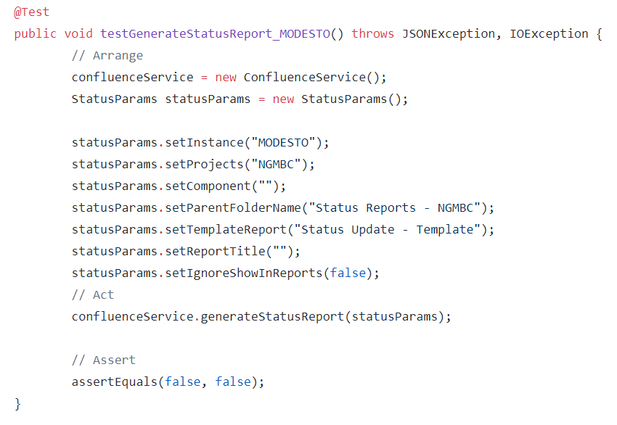

Slide 34
ONE LINE ONLY

Slide 35
ADDING YOUR SOCIAL MEDIA HANDLES

Slide 36
Exercise 6: Add your twitter handle, linkedin handle or email address to every slide (except the title slide)

Slide 37
Tell them what you told them

Slide 38
summary
WHAT WE
DID
In today’s lesson, we:
Created a Speaker Bio, Headshot and Abstract
Submitted a CFP
Learned Several Slide Techniques

Slide 39
Q&A

Slide 40
appendix

Slide 41
Exercise 3: Solution Make the next slide more clear by breaking it down

Slide 42
ELKaaS Components
Data Shippers
Filebeat – log data shipper
Packetbeat – real-time network analyzer
Topbeat – reads system-wide and per-process CPU and memory statistics
Customer provided shippers that can send data to Kafka APIs/endpoints
Logstash – open source data collection engine with real-time pipelining capabilities
Producers
Consumers
Elasticsearch – highly scalable open-source full-text search and analytics engine
Data node/s
Master node/s
Client node/s
Tribe node/s
Kibana – open source visualization platform
Kafka – distributed streaming platform
Zookeeper – centralized service for maintaing configuration information
Security - Access Controls, transport layer security (optional)

Slide 43
Exercise 4: solution make parts of the diagram appear with each click

Slide 45
Useful links
Scott Berkun – How and Why to Give an Ignite Talk ( https://bit.ly/2IHLZF8 )

